Slide 1
Sampling Time 1
Sampling Time 2
Sampling Time 3

Slide 3
Sampling Time 1
Sampling Time 2
Sampling Time 3

Slide 4
April 2022 figure recreate
Use these for paper

Slide 5
16S

Slide 7
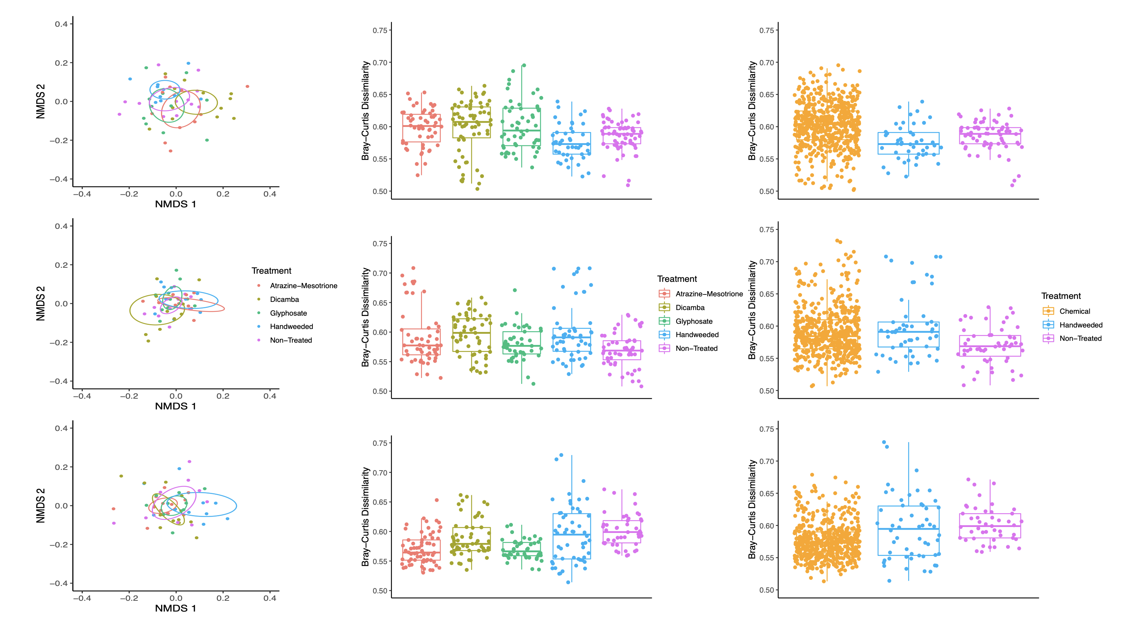

Slide 8
ITS

